Slide 1
DV1C04 Deployt & Monitoring in DevOps
L02
Configuration Management

Slide 2
Learning Objectives
Identify tools for Deploy Phase

Slide 3
What is Puppet?
Puppet is a configuration management and automation solution for servers.
When you use Puppet, you define the desired state of the systems you wish to control in your infrastructure.

Slide 4
What is Puppet?
This is accomplished by writing infrastructure code in Puppet's Domain-Specific Language (DSL) — Puppet code.
The code can be used on a variety of devices and operating systems.

Slide 5
What is Puppet?
The declarative nature of Puppet programming means that you specify the desired state of your systems rather than the processes required to get there.
Puppet then automates the process of attaining and keeping these systems in that state.

Slide 6
What is Puppet?
Puppet accomplishes this with the help of a Puppet agent and a Puppet primary server.
The Puppet primary server is where the code that describes your desired state is stored.
The Puppet agent transforms your code into instructions and then executes them on the systems you specify.

Slide 7
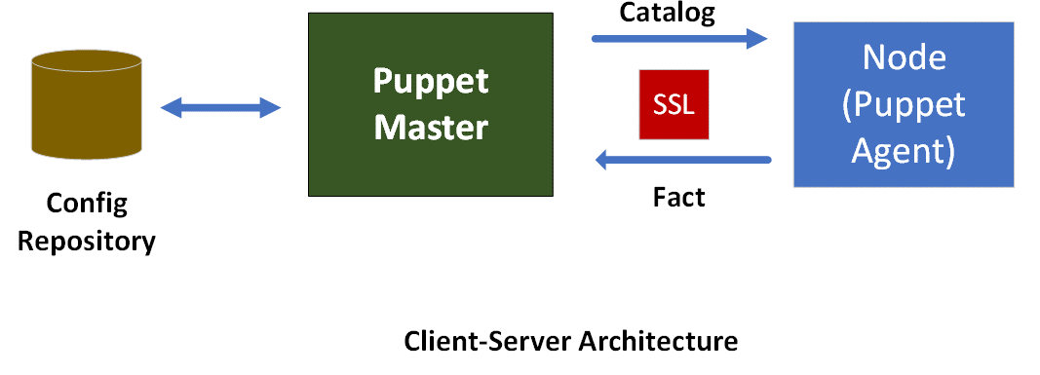
What is Puppet?
The server-agent architecture of a Puppet run is depicted in the diagram below.

Slide 8
Puppet's fundamental ideas
Infrastructure-as-code
Idempotency - Puppet produces same results independent of time or situation.
Agile methodology
Git and version control

Slide 9
Why Puppet?
Declarative
Increased Productivity
Deliveries that are consistent
Simplicity
Scalability is a also feature of Puppet.

Slide 10
Imperative vs Declarative
Imperative – Specify what to do and how to do.
Declarative – Not giving directions, just specify the final target location, specify what to do and NOT how to do.

Slide 11
Puppet Deployment Models
Standalone – more widely used for development/test/proof of concept (POC) environment.
Master Agent – more widely used in industry.

Slide 12
Use Case
Setup Packages
Firewall Ports Management
Change the configuration files
Control Services

Slide 13
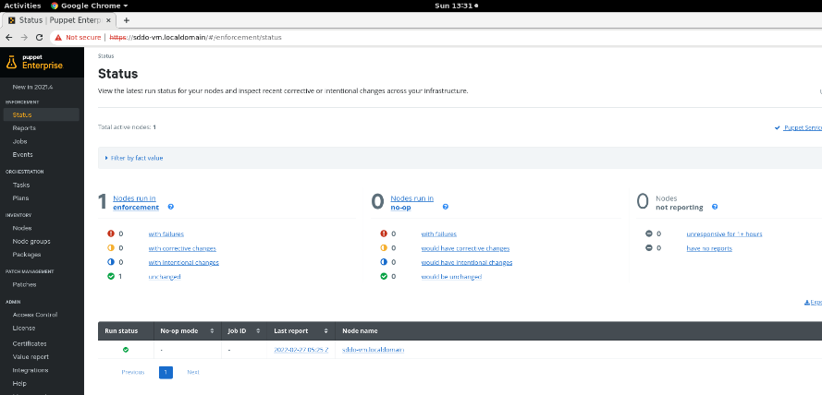
Open source Puppet vs Puppet Enterprise (PE)
Puppet Enterprise (PE) is commercial version, built on top of the open source Puppet framework.
You can handle the setup of thousands of nodes using both solutions.
PE is a better alternative if you have a complicated or massive infrastructure that is utilized and controlled by several teams.
Note: PE is used in the al the labs of this module.

Slide 14
The Puppet platform
Puppet is made up of a number of different packages.
The Puppet platform is what you use to organize, store, and run your Puppet code, and it's made up of all of these components.
Puppetserver
Puppetdb
Puppet-agent

Slide 15
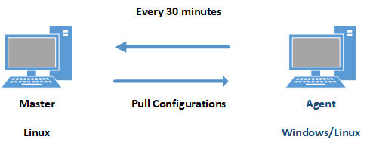
How Puppet Works?
Master-Agent (Production)

Slide 16

How Puppet Works?
Standalone (Dev/Test/POC)

Slide 17
Pull Mechanism
A Puppet agent connects to the Puppet master and opens a communication channel for retrieving commands every 30 minutes by default.
The settings that are present in the Puppet server are dynamically updated on the Puppet nodes.
Clients must check in to see if there have been any changes.

Slide 18
Manual Configuration vs Scripting vs Configuration Management
Manual Configuration | Scripting | Configuration Management
Create 20 users on 20 servers manually one by one. | Identify commands needed and convert them to scripts and run them on 20 servers to create 20 users on each server. | Use Puppet in-built resources by writing simple codes to create the 20 users on each of the 20 servers without worrying the underlying commands used in scripting.

Slide 19
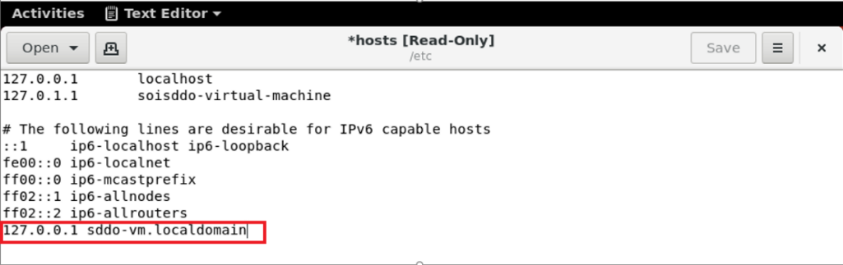
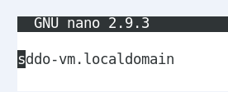
Pre-Requisites – (Install Puppet Master)
Static Hostname - /etc/hosts & /etc/hostname
System Requirements – 2 vCPU & 1 GB RAM
Supported Platform: Linux (No Windows Support)
Firewall Settings: Port 8140
Time Sync – use NTP server between master and agent

Slide 20
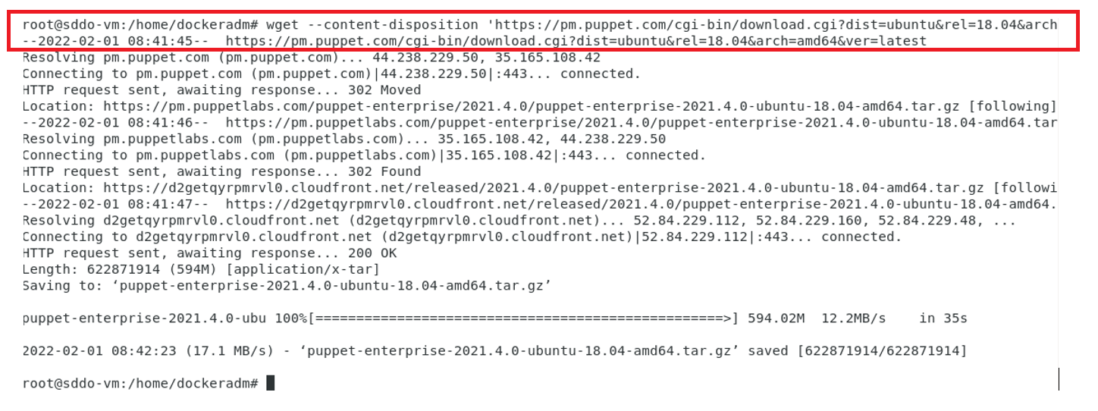
Install Puppet Master
Use package Manager such as yum or apt-get.
Resource such as Git or RPM.

Slide 21
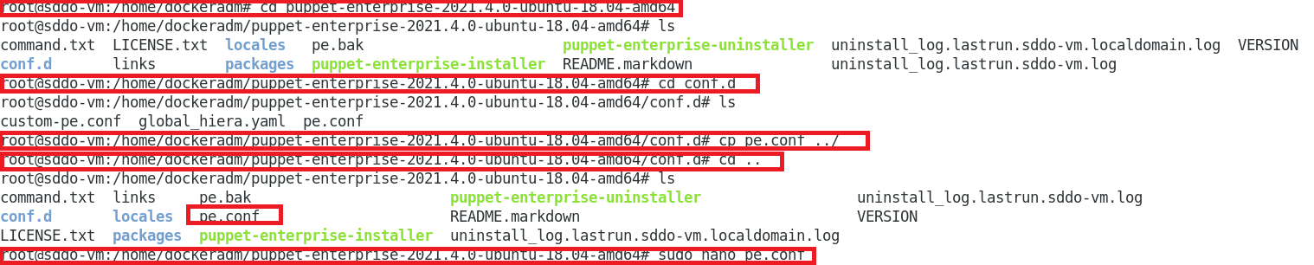
Install Puppet Master
Customise pe.conf file - A pe.conf file is a HOCON formatted file that declares parameters and values used to install, upgrade, or configure PE. A default pe.conf file is available in the conf.d directory in the installer tarball.

Slide 22
Certificate Management
sudo /opt/puppetlabs/bin/puppetserver ca sign –all
or Autosign.conf

Slide 23
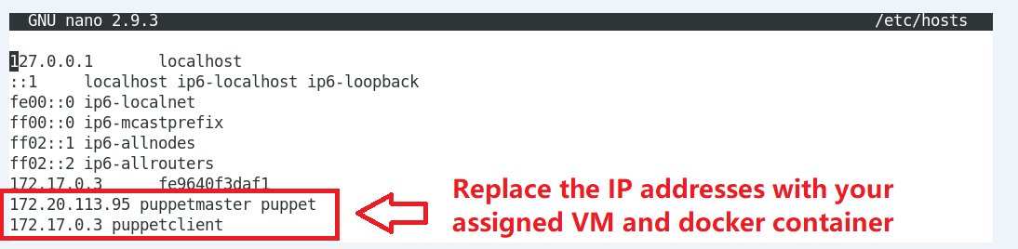
Pre-Requisites - (Install Puppet Agent)
Network Connectivity between the Puppet Master and Agent
Constant Hostname - /etc/hosts & /etc/hostname
System Requirements – 1 vCPU & 1 GB RAM
Supporting Platform (Linux/Windows)
Firewall Settings: Port 8140
Time Sync – use NTP server between master and agent

Slide 24
Puppet Building Blocks
Resource – inbuilt functions that performs individual functions such as related to file, user etc.
Class – combination of multiple resources e.g. everything required to setup a web service on a web server.
Manifest – directory that contains Puppet DSL files with pp extension.
Modules – reusable and sharable, following certain directory structure e.g. MySQL module to install MySQL or Jenkins module to manage Jenkins.

Slide 25
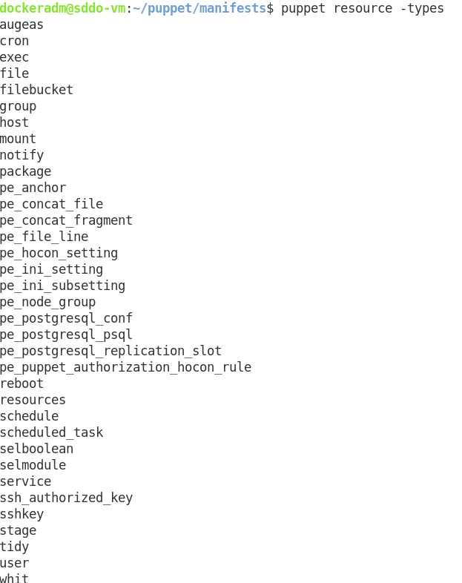
Resources
Core / Built-in - pre-built puppet resource types shipped with puppet software
Defined - lightweight resource types written in Puppet declarative language using a combination of existing resource types.
Custom – completely customized resource types written in written in Ruby

Slide 26
Code Creation Process
Create
Check – puppet parser validate – syntax check
Test – puppet apply –noop
Run – puppet apply

Slide 27
Puppet Commands
puppet help
puppet help resource –type | more
Puppet resource –types | wc –l
Puppet resource –types | grep -i user
Puppet describe user|more

Slide 28
References
https://puppet.com/docs/puppet/7/what_is_puppet.html
https://puppet.com/docs/puppet/7/why_use_puppet.html
https://puppet.com/docs/puppet/7/osp_vs_pe.html
https://puppet.com/docs/puppet/7/intro_puppet_language_and_code.html#intro_puppet_language_and_code
Puppet for Absolute Beginners - Hands-on by Mumshad Mannambeth, Yogesh Raheja

Slide 29
Thank you

